Slide 1
Module 1: Single-Area OSPFv2 Concepts
Instructor Materials
Enterprise Networking, Security, and Automationv7.0
(ENSA)
Notes:
Cisco Networking Academy Program
Enterprise Networking, Security, and Automationv7.0 (ENSA)
Module 1: Single-Area OSPFv2 Concepts

Slide 2
Module 1: Single-Area OSPFv2 Concepts
Enterprise Networking, Security, and Automation v7.0
(ENSA)
Notes:
Cisco Networking Academy Program
Enterprise Networking, Security, and Automationv7.0 (ENSA)
Module 1: Single-Area OSPFv2 Concepts

Slide 3
Module Objectives
Module Title: Single-Area OSPF Concepts
Module Objective: Explain how single-area OSPF operates in both point-to-point and broadcast multiaccess networks.
Topic Title | Topic Objective
OSPF Features and Characteristics | Describe basic OSPF features and characteristics.
OSPF Packets | Describe the OSPF packet types used in single-area OSPF.
OSPF Operation | Explain how single-area OSPF operates.
Notes:
3
1 – Single-Area OSPFv2
1.0.2 – What will I learn to do in this Module?

Slide 4
1.1 OSPF Features and Characteristics
Notes:
1 - Single-Area OSPFv2 Concepts
1.1 - OSPF Features and Characteristics

Slide 5
OSPF Features and Characteristics
Introduction to OSPF
OSPF is a link-state routing protocol that was developed as an alternative for the distance vector Routing Information Protocol (RIP). OSPF has significant advantages over RIP in that it offers faster convergence and scales to much larger network implementations.
OSPF is a link-state routing protocol that uses the concept of areas. A network administrator can divide the routing domain into distinct areas that help control routing update traffic.
  A link is an interface on a router, a network segment that connects two routers, or a stub network such as an Ethernet LAN that is connected to a single router.
  Information about the state of a link is known as a link-state. All link-state information includes the network prefix, prefix length, and cost.
This module covers basic, single-area OSPF implementations and configurations.
Notes:
1 - Single-Area OSPFv2 Concepts
1.1 - OSPF Features and Characteristics
1.1.1 - Introduction to OSPF

Slide 6
OSPF Features and Characteristics
Components of OSPF
All routing protocols share similar components. They all use routing protocol messages to exchange route information. The messages help build data structures, which are then processed using a routing algorithm.
Routers running OSPF exchange messages to convey routing information using five types of packets:
  Hello packet
  Database description packet
  Link-state request packet
  Link-state update packet
  Link-state acknowledgment packet
These packets are used to discover neighboring routers and also to exchange routing information to maintain accurate information about the network.
Notes:
1 - Single-Area OSPFv2 Concepts
1.1 - OSPF Features and Characteristics
1.1.2 - Components of OSPF

Slide 7
OSPF Features and Characteristics
Components of OSPF (Cont.)
OSPF messages are used to create and maintain three OSPF databases, as follows:
Database | Table | Description
Adjacency Database | Neighbor Table | List of all neighbor routers to which a router has established bi-directional communication. This table is unique for each router. Can be viewed using the show ip ospf neighbor command.
Link-state Database (LSDB) | Topology Table | Lists information about all other routers in the network. The database represents the network LSDB. All routers within an area have identical LSDB. Can be viewed using the show ip ospf database command.
Forwarding Database | Routing Table | List of routes generated when an algorithm is run on the link-state database. Each router's routing table is unique and contains information on how and where to send packets to other routers. Can be viewed using the show ip route command.
Notes:
1 - Single-Area OSPFv2 Concepts
1.1 - OSPF Features and Characteristics
1.1.2 - Components of OSPF (Cont.)

Slide 8
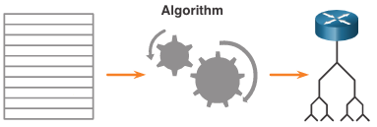
OSPF Features and Characteristics
Components of OSPF (Cont.)
The router builds the topology table using results of calculations based on the Dijkstra shortest-path first (SPF) algorithm. The SPF algorithm is based on the cumulative cost to reach a destination.
The SPF algorithm creates an SPF tree by placing each router at the root of the tree and calculating the shortest path to each node. The SPF tree is then used to calculate the best routes. OSPF places the best routes into the forwarding database, which is used to make the routing table.
Notes:
1 - Single-Area OSPFv2 Concepts
1.1 - OSPF Features and Characteristics
1.1.2 - Components of OSPF (Cont.)

Slide 9
OSPF Features and Characteristics
Link-State Operation
To maintain routing information, OSPF routers complete a generic link-state routing process to reach a state of convergence. The following are the link-state routing steps that are completed by a router:
Establish Neighbor Adjacencies
Exchange Link-State Advertisements
Build the Link State Database
Execute the SPF Algorithm
Choose the Best Route
Notes:
1 - Single-Area OSPFv2 Concepts
1.1 - OSPF Features and Characteristics
1.1.3 - Link-State Operation

Slide 10
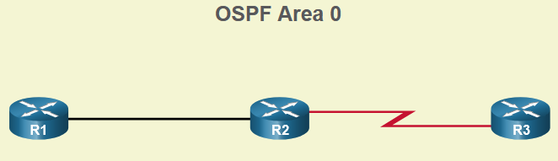
OSPF Features and Characteristics
Single-Area and Multiarea OSPF
To make OSPF more efficient and scalable, OSPF supports hierarchical routing using areas. An OSPF area is a group of routers that share the same link-state information in their LSDBs. OSPF can be implemented in one of two ways, as follows:
Single-Area OSPF - All routers are in one area. Best practice is to use area 0.
Multiarea OSPF - OSPF is implemented using multiple areas, in a hierarchical fashion. All areas must connect to the backbone area (area 0). Routers interconnecting the areas are referred to as Area Border Routers (ABRs).
The focus of this module is on single-area OSPFv2.
Notes:
1 - Single-Area OSPFv2 Concepts
1.1 - OSPF Features and Characteristics
1.1.4 - Single-Area and Multiarea OSPF

Slide 11
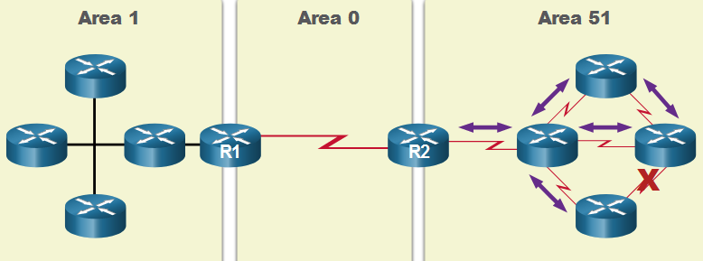
OSPF Features and Characteristics
Multiarea OSPF
The hierarchical-topology design options with multiarea OSPF can offer the following advantages.
  Smaller routing tables - Tables are smaller because there are fewer routing table entries. This is because network addresses can be summarized between areas. Route summarization is not enabled by default.
  Reduced link-state update overhead - Designing multiarea OSPF with smaller areas minimizes processing and memory requirements.
  Reduced frequency of SPF calculations -– Multiarea OSPF localize the impact of a topology change within an area. For instance, it minimizes routing update impact because LSA flooding stops at the area boundary.
Notes:
1 - Single-Area OSPFv2 Concepts
1.1 - OSPF Features and Characteristics
1.1.5 - Multiarea OSPF

Slide 12
OSPF Features and Characteristics
OSPFv3
OSPFv3 is the OSPFv2 equivalent for exchanging IPv6 prefixes. OSPFv3 exchanges routing information to populate the IPv6 routing table with remote prefixes.
  Note: With the OSPFv3 Address Families feature, OSPFv3 includes support for both IPv4 and IPv6. OSPF Address Families is beyond the scope of this curriculum.
OSPFv3 has the same functionality as OSPFv2, but uses IPv6 as the network layer transport, communicating with OSPFv3 peers and advertising IPv6 routes. OSPFv3 also uses the SPF algorithm as the computation engine to determine the best paths throughout the routing domain.
OSPFv3 has separate processes from its IPv4 counterpart. The processes and operations are basically the same as in the IPv4 routing protocol, but run independently.
Notes:
1 - Single-Area OSPFv2 Concepts
1.1 - OSPF Features and Characteristics
1.1.6 - OSPFv3
1.1.7 - Check Your Understanding - OSPF Features and Characteristics

Slide 13
1.2 OSPF Packets
Notes:
1 - Single-Area OSPFv2 Concepts
1.2 - OSPF Packets

Slide 14
OSPF Packets
Types of OSPF Packets
The table summarizes the five different types of Link State Packets (LSPs) used by OSPFv2. OSPFv3 has similar packet types.
Type | Packet Name | Description
1 | Hello | Discovers neighbors and builds adjacencies between them
2 | Database Description (DBD) | Checks for database synchronization between routers
3 | Link-State Request (LSR) | Requests specific link-state records from router to router
4 | Link-State Update (LSU) | Sends specifically requested link-state records
5 | Link-State Acknowledgment (LSAck) | Acknowledges the other packet types
Notes:
1 - Single-Area OSPFv2 Concepts
1.2 - OSPF Packets
1.2.2 – Types of OSPF Packets

Slide 15
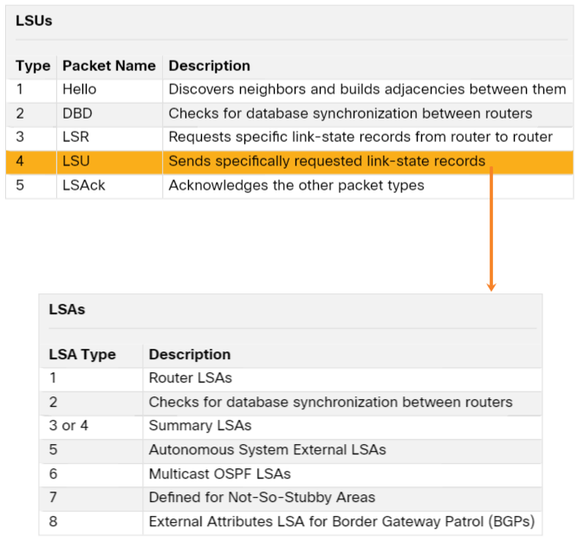
OSPF Packets
Link-State Updates
LSUs are also used to forward OSPF routing updates. An LSU packet can contain 11 different types of OSPFv2 LSAs. OSPFv3 renamed several of these LSAs and also contains two additional LSAs.
LSU and LSA are often used interchangeably, but the correct hierarchy is LSU packets contain LSA messages.
Notes:
1 - Single-Area OSPFv2 Concepts
1.2 - OSPF Packets
1.2.3 – Link-State Updates

Slide 16
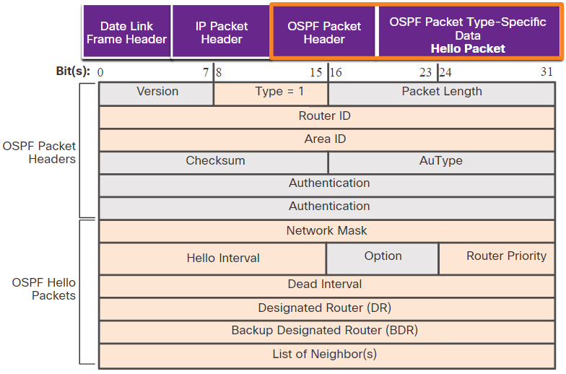
OSPF Packets
Hello Packet
The OSPF Type 1 packet is the Hello packet. Hello packets are used to do the following:
Discover OSPF neighbors and establish neighbor adjacencies.
Advertise parameters on which two routers must agree to become neighbors.
Elect the Designated Router (DR) and Backup Designated Router (BDR) on multiaccess networks like Ethernet. Point-to-point links do not require DR or BDR.
Notes:
1 - Single-Area OSPFv2 Concepts
1.2 - OSPF Packets
1.2.4 – Hello Packet
1.2.5 – Check Your Understanding – OSPF Packets

Slide 17
1.3 OSPF Operation
Notes:
1 - Single-Area OSPFv2 Concepts
1.3 - OSPF Operation

Slide 18
OSPF Operation
OSPF Operational States
State | Description
Down State | No Hello packets received = Down. Router sends Hello packets. Transition to Init state.
Init State | Hello packets are received from the neighbor. They contain the Router ID of the sending router. Transition to Two-Way state.
Two-Way State | In this state, communication between the two routers is bidirectional. On multiaccess links, the routers elect a DR and a BDR. Transition to ExStart state.
Notes:
1 - Single-Area OSPFv2 Concepts
1.3 - OSPF Operation
1.3.2 - OSPF Operational States

Slide 19
OSPF Operation
OSPF Operational States (Cont.)
State | Description
ExStart State | On point-to-point networks, the two routers decide which router will initiate the DBD packet exchange and decide upon the initial DBD packet sequence number.
Exchange State | Routers exchange DBD packets. If additional router information is required then transition to Loading; otherwise, transition to the Full state.
Loading State | LSRs and LSUs are used to gain additional route information. Routes are processed using the SPF algorithm. Transition to the Full state.
Full State | The link-state database of the router is fully synchronized.
Notes:
1 - Single-Area OSPFv2 Concepts
1.3 - OSPF Operation
1.3.2 - OSPF Operational States (Cont.)

Slide 20
OSPF Operation
Establish Neighbor Adjacencies
To determine if there is an OSPF neighbor on the link, the router sends a Hello packet that contains its router ID out all OSPF-enabled interfaces. The Hello packet is sent to the reserved All OSPF Routers IPv4 multicast address 224.0.0.5. Only OSPFv2 routers will process these packets.
The OSPF router ID is used by the OSPF process to uniquely identify each router in the OSPF area. A router ID is a 32-bit number formatted like an IPv4 address and assigned to uniquely identify a router among OSPF peers.
When a neighboring OSPF-enabled router receives a Hello packet with a router ID that is not within its neighbor list, the receiving router attempts to establish an adjacency with the initiating router.
Notes:
1 - Single-Area OSPFv2 Concepts
1.3 - OSPF Operation
1.3.3 - Establish Neighbor Adjacencies

Slide 21
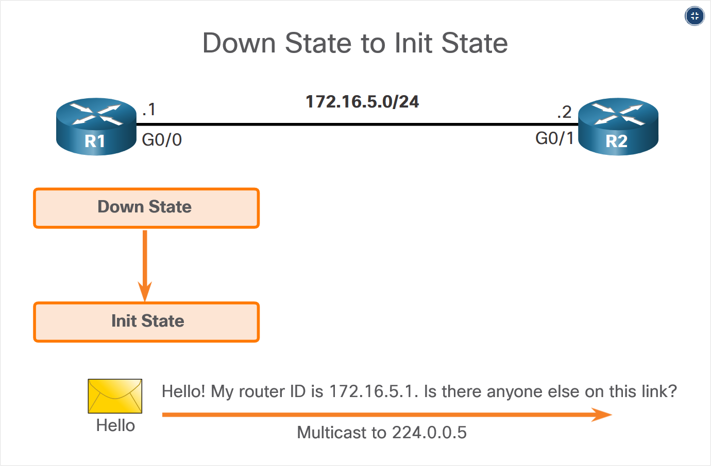
OSPF Operation
Establish Neighbor Adjacencies – Down State
Notes:
1 - Single-Area OSPFv2 Concepts
1.3 - OSPF Operation
1.3.3 - Establish Neighbor Adjacencies

Slide 22
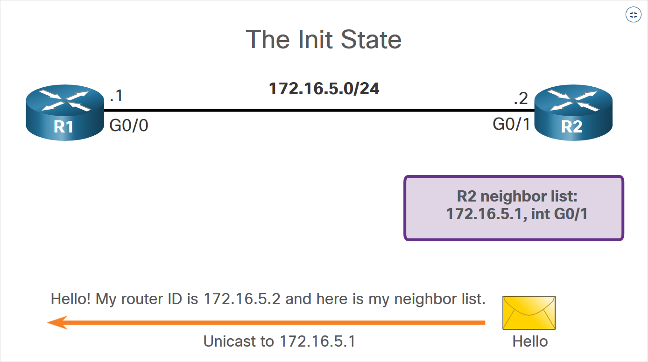
OSPF Operation
Establish Neighbor Adjacencies – Init State
Notes:
1 - Single-Area OSPFv2 Concepts
1.3 - OSPF Operation
1.3.3 - Establish Neighbor Adjacencies

Slide 23
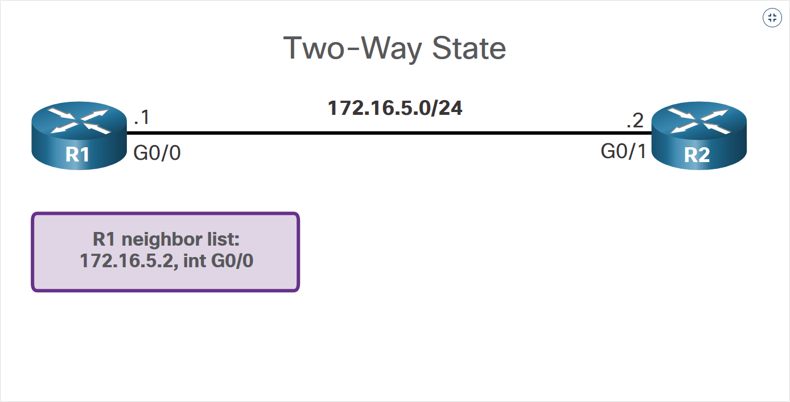
OSPF Operation
Establish Neighbor Adjacencies – Two-Way State
Notes:
1 - Single-Area OSPFv2 Concepts
1.3 - OSPF Operation
1.3.3 - Establish Neighbor Adjacencies

Slide 24
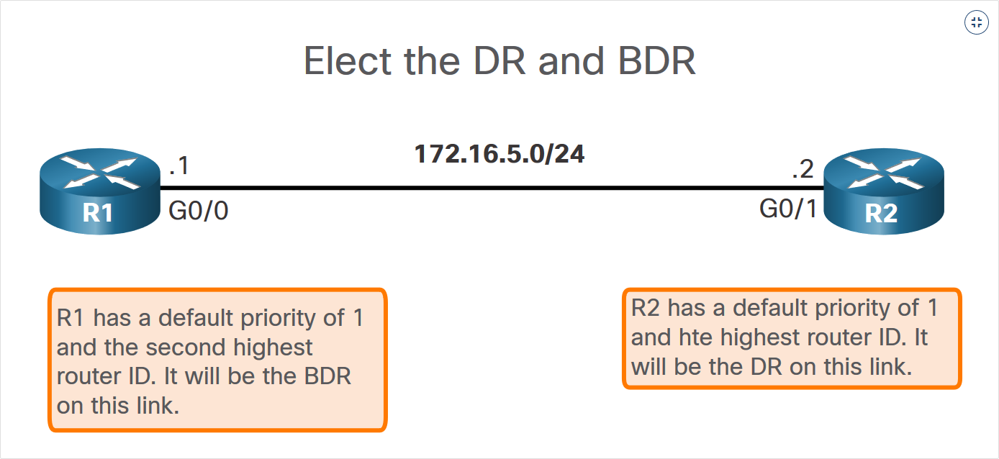
OSPF Operation
Establish Neighbor Adjacencies – Two-Way State (Cont.)
Notes:
1 - Single-Area OSPFv2 Concepts
1.3 - OSPF Operation
1.3.3 - Establish Neighbor Adjacencies

Slide 25
OSPF Operation
Synchronizing OSPF Databases
After the Two-Way state, routers transition to database synchronization states. This is a three step process, as follows:
  Decide first router: The router with the highest router ID sends its DBD first.
  Exchange DBDs: As many as needed to convey the database. The other router must acknowledge each DBD with an LSAck packet.
  Send an LSR: Each router compares the DBD information with the local LSDB. If the DBD has more current link information, the router transitions to the loading state.
  After all LSRs have been exchanged and satisfied, the routers are considered synchronized and in a full state. Updates (LSUs) are sent:
  When a change is perceived (incremental updates)
  Every 30 minutes
Notes:
1 - Single-Area OSPFv2 Concepts
1.3 - OSPF Operation
1.3.4 - Synchronizing OSPF Databases

Slide 26
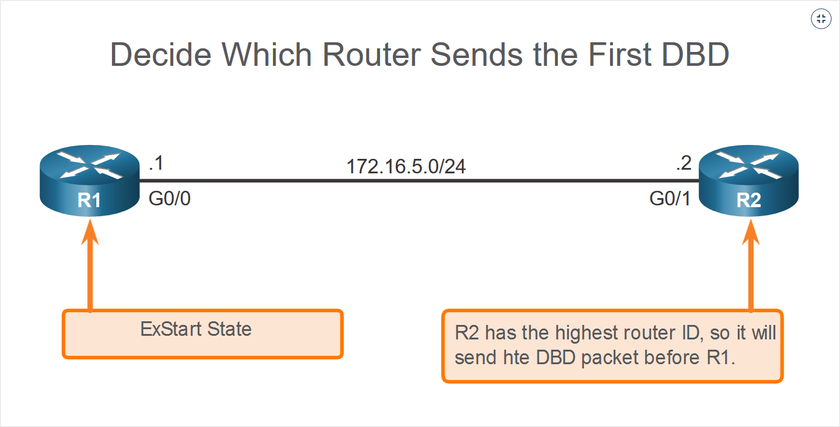
OSPF Operation
Synchronizing OSPF Databases - ExStart
Notes:
1 - Single-Area OSPFv2 Concepts
1.3 - OSPF Operation
1.3.3 - Establish Neighbor Adjacencies

Slide 27
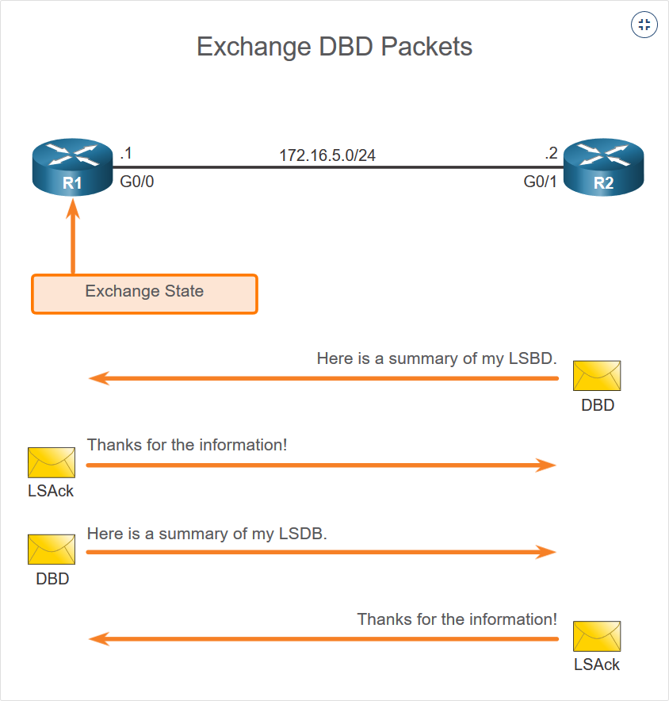
OSPF Operation
Synchronizing OSPF Databases - Exchange
Notes:
1 - Single-Area OSPFv2 Concepts
1.3 - OSPF Operation
1.3.3 - Establish Neighbor Adjacencies

Slide 28
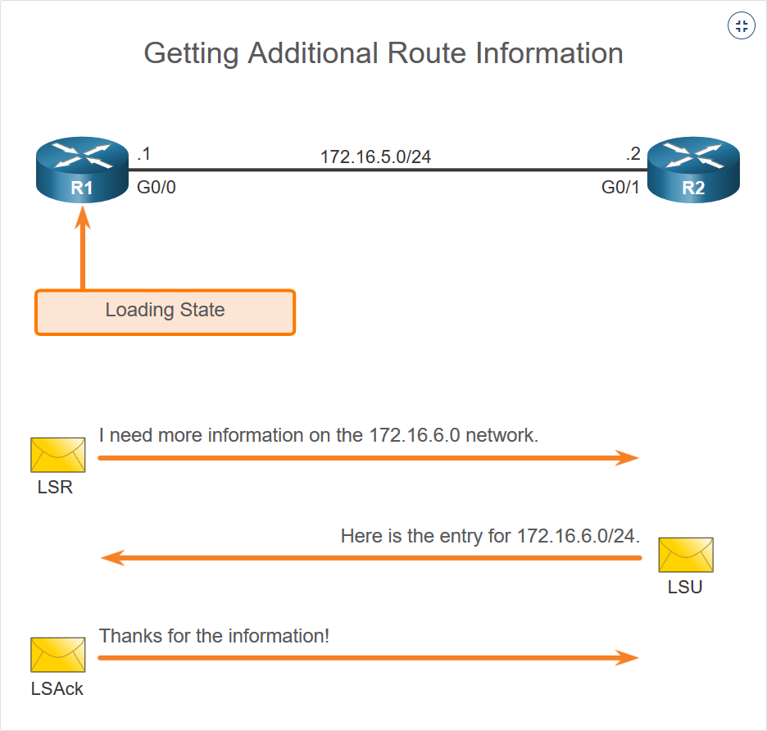
OSPF Operation
Synchronizing OSPF Databases - Loading
Notes:
1 - Single-Area OSPFv2 Concepts
1.3 - OSPF Operation
1.3.3 - Establish Neighbor Adjacencies

Slide 29
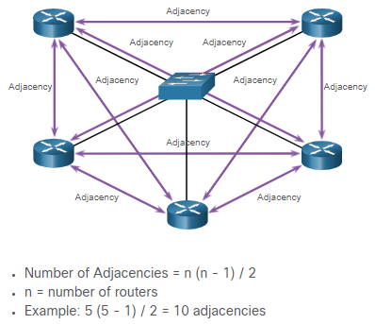
OSPF Operation
The Need for a DR
Multiaccess networks can create two challenges for OSPF regarding the flooding of LSAs, as follows:
Creation of multiple adjacencies - Ethernet networks could potentially interconnect many OSPF routers over a common link. Creating adjacencies with every router would lead to an excessive number of LSAs exchanged between routers on the same network.
Extensive flooding of LSAs - Link-state routers flood their LSAs any time OSPF is initialized, or when there is a change in the topology. This flooding can become excessive.
Notes:
1 - Single-Area OSPFv2 Concepts
1.3 - OSPF Operation
1.3.5 – The Need for a DR

Slide 30
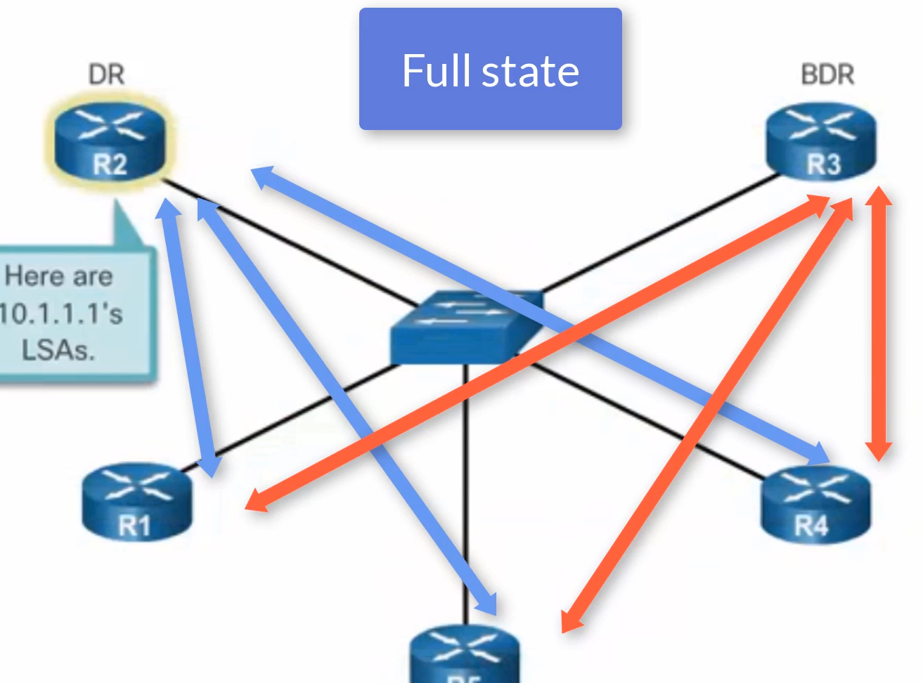
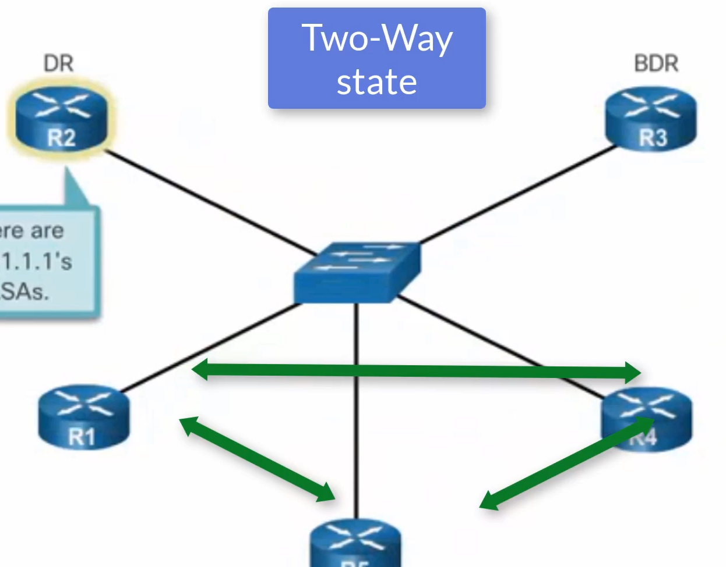
OSPF Operation
LSA Flooding with a DR
Notes:
1 - Single-Area OSPFv2 Concepts
1.3 - OSPF Operation
1.3.6 - LSA Flooding with a DR
1.3.7 – Check Your Understanding – OSPF Operation

